Slide 1

Car Rider Pickup System for Schools
Haya Abusada, Jake Hewett, Jayden Pearson, Jack Uehlinger, Sara Vorhaben

Slide 2
Problem Background
Over 70% of students are now picked up via car, creating massive congestion.
Parents wait up to 1 hour, with lines often forming 1-2 hours before dismissal.
Queues spill onto local highways, causing traffic backups and increasing accident risks.
Inclement weather increases delays as bus and bike riders often switch to the car line.
The manual process requires 5-10 staff members daily, diverting them from educational duties.

Slide 3
Problem - Needs Statement
School pickup via the car rider line has been increasing in the US over the years leading to an increase in line length and pickup time. Now, over 70% of students are picked up from school via the car rider line. Car rider lines have become congested, posing a safety issue for both the students and other drivers. With more students attending school, car rider lines have become too slow and cause parents to wait up to over an hour in line leading to frustration. Some studies show that the car rider pick-up line starts to form 1-2 hours before school actually gets out, which leads to traffic backing up local highways and streets, and even frequent accidents. Inclement weather further slows the line, as students who ride the bus or bike to school will often be picked up by their parents in the car rider line to avoid the weather. Additionally, 5-10 staff members are required to set up and run the pickup process, diverting their time away from the education of students. An automated system is needed to streamline the pick-up process to decrease delays and safety issues.

Slide 4
Goal and Objectives
Goal
The goal of this project is to design and prototype a system that will help automate the car rider pick up process at schools. The system is built to reduce the amount of time necessary to pick up students from school.
Objectives
The system will allow parents to update their information (license plate numbers, approved adults for pickup, car rider schedules) via a website with approval from a staff member of the school.
The system will read the marker on the car (license plate, QR code, nametag) as it enters the pickup line and send the information to a server.
The server will identify the parent and child associated with the car marker, and update a display at the entrance of the pickup line to direct the car to the proper station.
The laptop at the front of the school is updated to inform the students and staff which child is being picked up, and which zone to go to.

Slide 5
Goal and Objectives - Requirements
Marketing Requirements
Make the pickup process faster for parents
The system should be easily updated
The system should be low cost
The system should be easy to use/install
Information must be validated if updated or inserted
Student safety should be ensured (information, physical, etc.)
The system should be reliable

Slide 6
Goal and Objectives - Requirements
Marketing Requirements | Engineering Requirements
1 | Pickup time should be reduced by 30% per 100 kids. The time from the car entering the view of the camera to information being displayed should be no more than 5 seconds.
4 | 7 inch (diagonal) display screen to give station and process instructions clearly.
1, 6 | Per Texas Family Code, ensure that students are referred to authorized parents 100% of the time.
6 | Private Information stored in the database should be encrypted using 128 bit encryption.
7 | Should have a stable connection from within 1 kilometer, stable power to all components.
1,6,7 | Should correctly identify/assign parents to kids 100% of the time.
3 | The costs for developing the system should not exceed $300.
2,4,5 | The system should allow parents to submit a request to the school to update information and the school should receive the request all within 1 minute.

Slide 7
Goal and Objectives - Requirements
Marketing Requirements | Engineering Requirements
4 | The system should have a modular design such that failed components can be replaced by a technician in under 15 minutes.
4,7 | The system should be mounted correctly on a tripod to ensure stability and prevent hazards. Sandbag/Weights of at least 1 pound to keep it grounded.
7 | The software will comply with the Digital Millennium Copyright Act.
2,4,5,6 | Staff should be able to access databases with provided credentials and view all parent to children links.
4,7 | The system should be able to withstand 20mph wind.
1 | Minimum 40inch (diagonal) display screen to give station and process instructions clearly inside in the pickup .
4 | The system should have a modular design such that failed components can be replaced by a technician in under 15 minutes.
4,7 | The system should be mounted correctly on a tripod to ensure stability and prevent hazards. Sandbag/Weights of at least 1 pound to keep it grounded.

Slide 8
Design Constraints and Feasibility
Technical and Temporal Constraints
Maximum of 5 seconds from image capture to display update
Identification accuracy must be 100% to ensure safety and efficiency
Connection between the system parts must be reliable
Physical and Environmental
Needs to withstand outdoor elements (wind and rain)
Needs to be portable and stable with modular parts, mounting, and power supply to reduce system downtime and speed up repair and maintenance
Economic
Must cost $250 or less, necessitating cost-effective components
Feasibility
Core technology, such as Python image processing and Wi-Fi, is well documented and achievable
Main challenge will be creating a fast and efficient system within our budget

Slide 9
Evaluation of alternative solutions and Rationale
Solution | Pros | Cons
Manual Pickup App (PikMyKid) | Easy to implement; low cost; reduces paperwork | Requires staff queue management; no automated vehicle identification
Integrated Dismissal System (Beeline) | Improves communication; integrates with school systems | Requires training and infrastructure; still staff-monitored
Geofencing (Car-Pool App) | Real-time arrival alerts; reduced manual check-ins | Dependent on GPS accuracy, mobile devices, and connectivity
GPS Check-In (IschoolRide) | Keeps students inside until arrival; reduces idle staging | Relies on parent app usage and accurate GPS; staff verification will still be needed
QR Codes (Kids Pick Up App) | Simple, affordable; no cellular service required | Requires staff scanning; affected by glare, weather, and visibility
All alternatives improve organization but still rely on staff actions or parent interaction, limiting full automation.

Slide 10



System Level Functional Description - High-Level Block Diagram
Car line entrance
Recognize car identifier (license plate or QR code)
Send and receive data
Over zigbee
Instruct parents what zone to go to
Display pickup information to staff
Allow staff to update system once a kid has been picked up
Forward data between car entrance module and main server module
Car Entrance Module
Zone Pickup Module
Car Stations
--------------------------------
Display website which contains instructions to send kid to car stations
Kids Waiting Module
Host a website that can be updated in real time
Connect to a database that contains parent/kid info
Handle information update requests from parents
Send updates to car entrance module
Main Server Module
Notes:
range

Slide 11
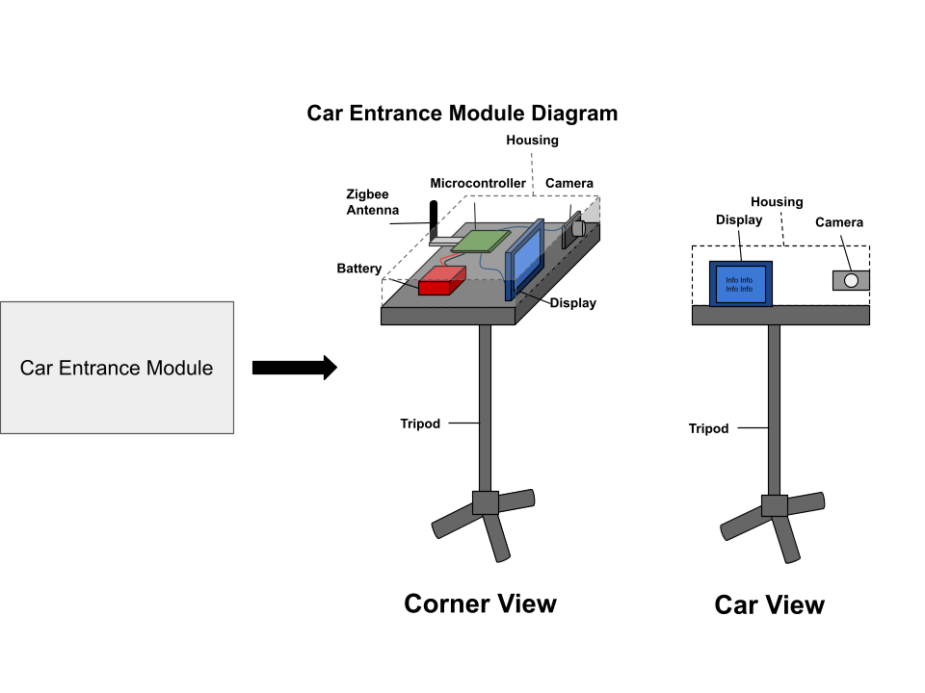
System Component - Car Entrance Module
Hardware:
Microcontroller for processing and controlling devices
Camera for images
Display for instructing parents
Zigbee antenna for radio communication
Rechargeable battery for power
Software:
Image processing and recognition software
Display instructions on screen
Zigbee communication software
Interfaces:
Inputs:
Images
Zigbee data
Outputs:
Display information to instruct parents
Zigbee data

Slide 12
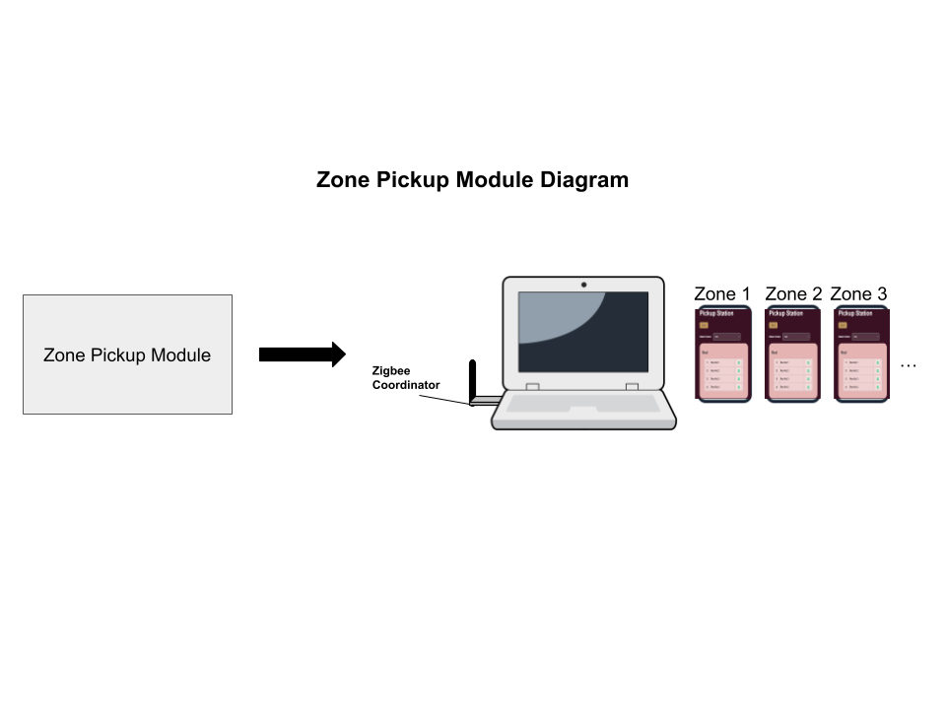
System Component - Zone Pickup Module
Hardware:
Laptop for software and zigbee connection
Zigbee antenna for radio communication
Phones to show specific zone information to zone attendant
Software:
Zigbee communication software
Website access on phones
Interfaces:
Inputs:
Zigbee data
Button input on phones once a kid has been picked up
Server data (updates for car entrance module)
Outputs:
Zigbee data

Slide 13
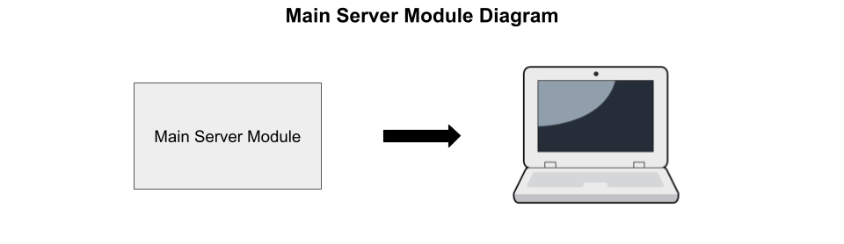
System Component - Main Server Module
Hardware:
Computer to run software
Software:
Website hosting - needs real time updating
Database connection to access and update parents/kids info
Send updates to car entrance module display
Interfaces:
Inputs:
Identifier data (to query database to find parent and kid)
Parent requests (to update information)
Outputs:
Information to update car entrance module display

Slide 14
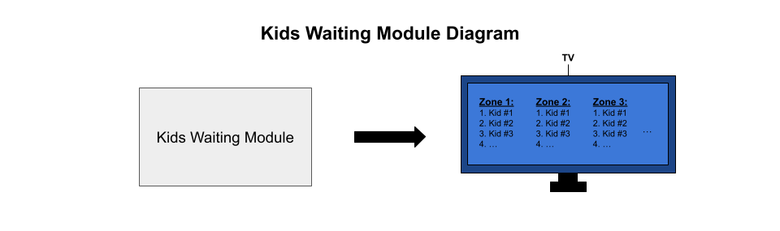
System Component - Kids Waiting Module
Hardware:
Large display (projector or large TV)
Software:
Website access on screen
Interfaces:
Inputs: None
Outputs:
Website to instruct kids and staff when to
send kid to zones to be picked up (also which
zone to go to)

Slide 15
Design Validation and Testing - 1
Small, foundational testing first
Verify connectivity to web server and database
Display text found by the camera directly to the screen it is connected to
Ping router from the car entrance module to verify connectivity
QUERY database to ensure proper initialization
System testing comes next
Packets should be sent to the database, should return student names
Screens directing drivers and students should update in no more than 5 seconds
Web server flags incoming requests to alter database to admin page
Notes:
Improve specs with respect to requirements

Slide 16
Design Validation and Testing - 2
End with Full System Functionality Tests:
Run full pickup simulation
Scan QR code
Send information to Server
Inform kid they are being picked up
Kid goes to the line
Kid gets in the car
Notes:
Improve specs with respect to requirements

Slide 17
Vision for Product Demonstration
Film a video of the full system test
Set up each of the modules in locations similar to what the school would look like and go through the process of picking up a queue of students
Live QR code scanning and site updates
Website - https://thewranglers.onrender.com/
Notes:
Improve specs with respect to requirements

Slide 18
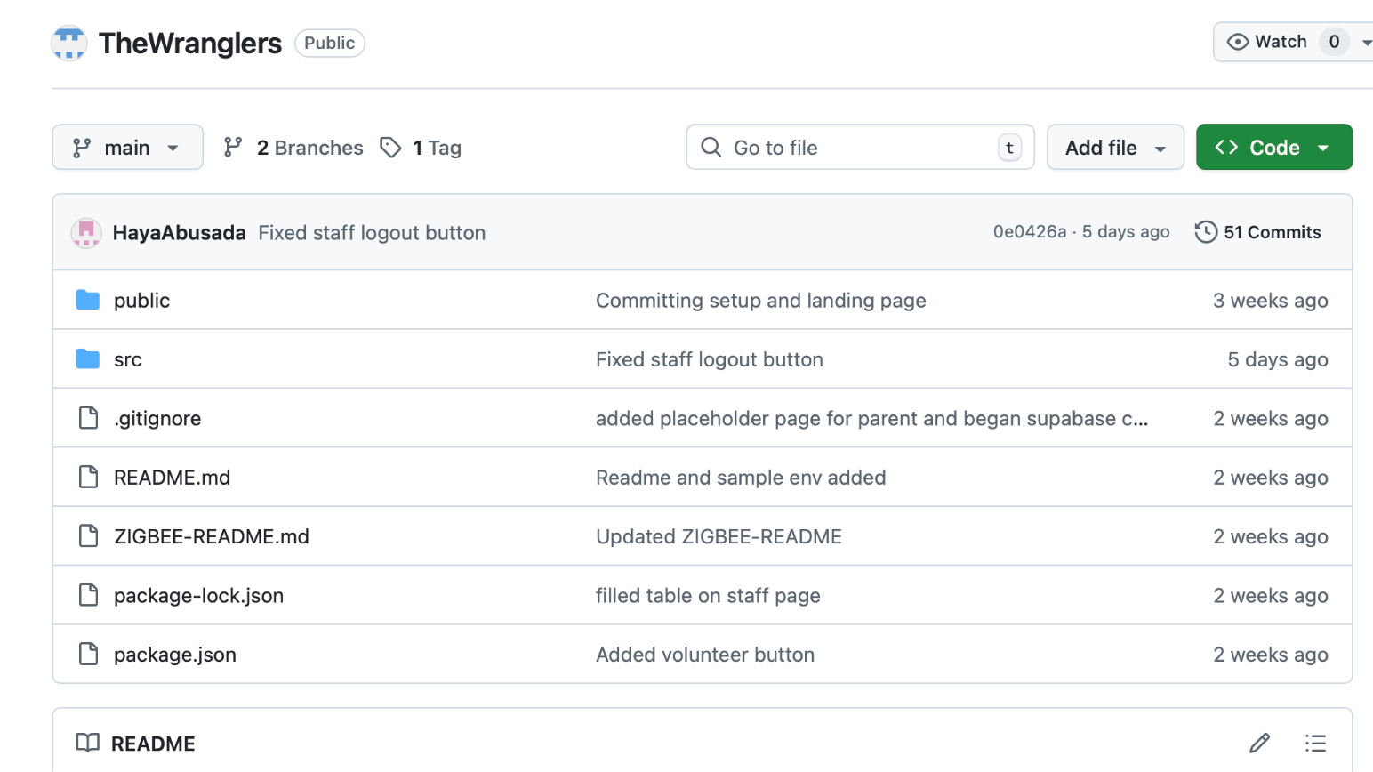
Evidence of Effective Teaming
Defined Roles and Responsibilities
Each team member is responsible for a specific subsystem:
Haya Abusada – Frontend development and system integration
Sara Vorhaben – Backend development and authentication
Jake Hewett – Database architecture and administrative interface
Jack Uehlinger – Hardware and camera integration
Jayden Pearson – Mechanical design and enclosure development
This ensures clear ownership of tasks and efficient development.
Collaboration and Communication
The team maintains strong coordination through:
Weekly team meetings to review progress and address issues
GitHub for version control and collaborative development
Discord for daily communication and troubleshooting
Google Drive for shared documentation and reports
Screenshot of Github Repo

Slide 19
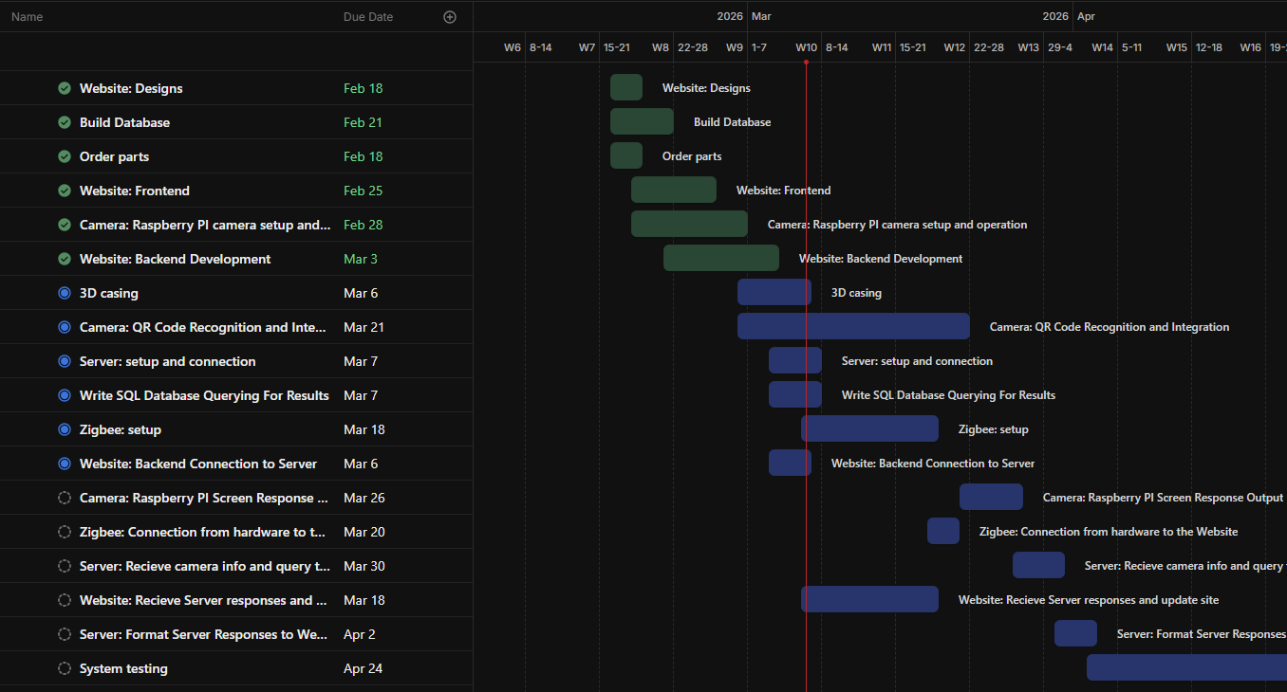
Evidence of Effective Teaming - Gantt Chart
Gantt Chart Shows tasks completed
Red line is today
All tasks are completed on time

Slide 20
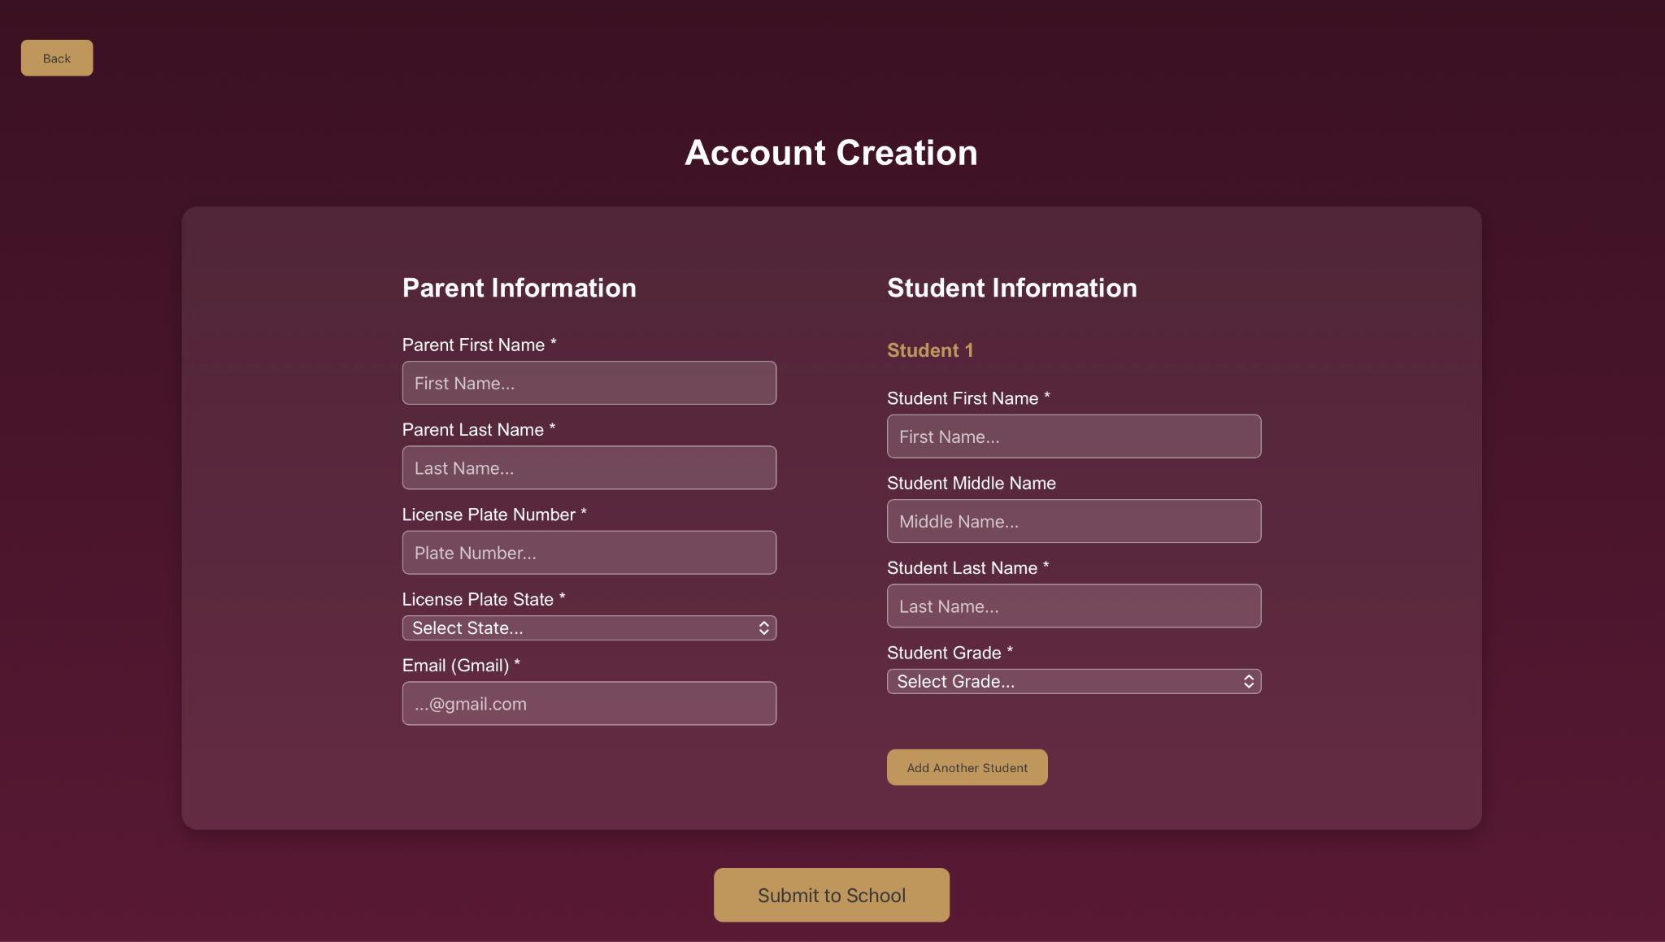
Preliminary Results
System Development Progress
Web-based interface developed using React
Major pages implemented:
Landing page
Parent portal
Administrative pages
Kids pickup module
Website successfully deployed and connected to database.
Parent Portal Functionality
Google authentication implemented for secure login
Parents can:
Register student information
Update license plate details
View student pickup status
Website successfully reads and writes data to the database
Account creation page of the website to enter required info and create new accounts.

Slide 21
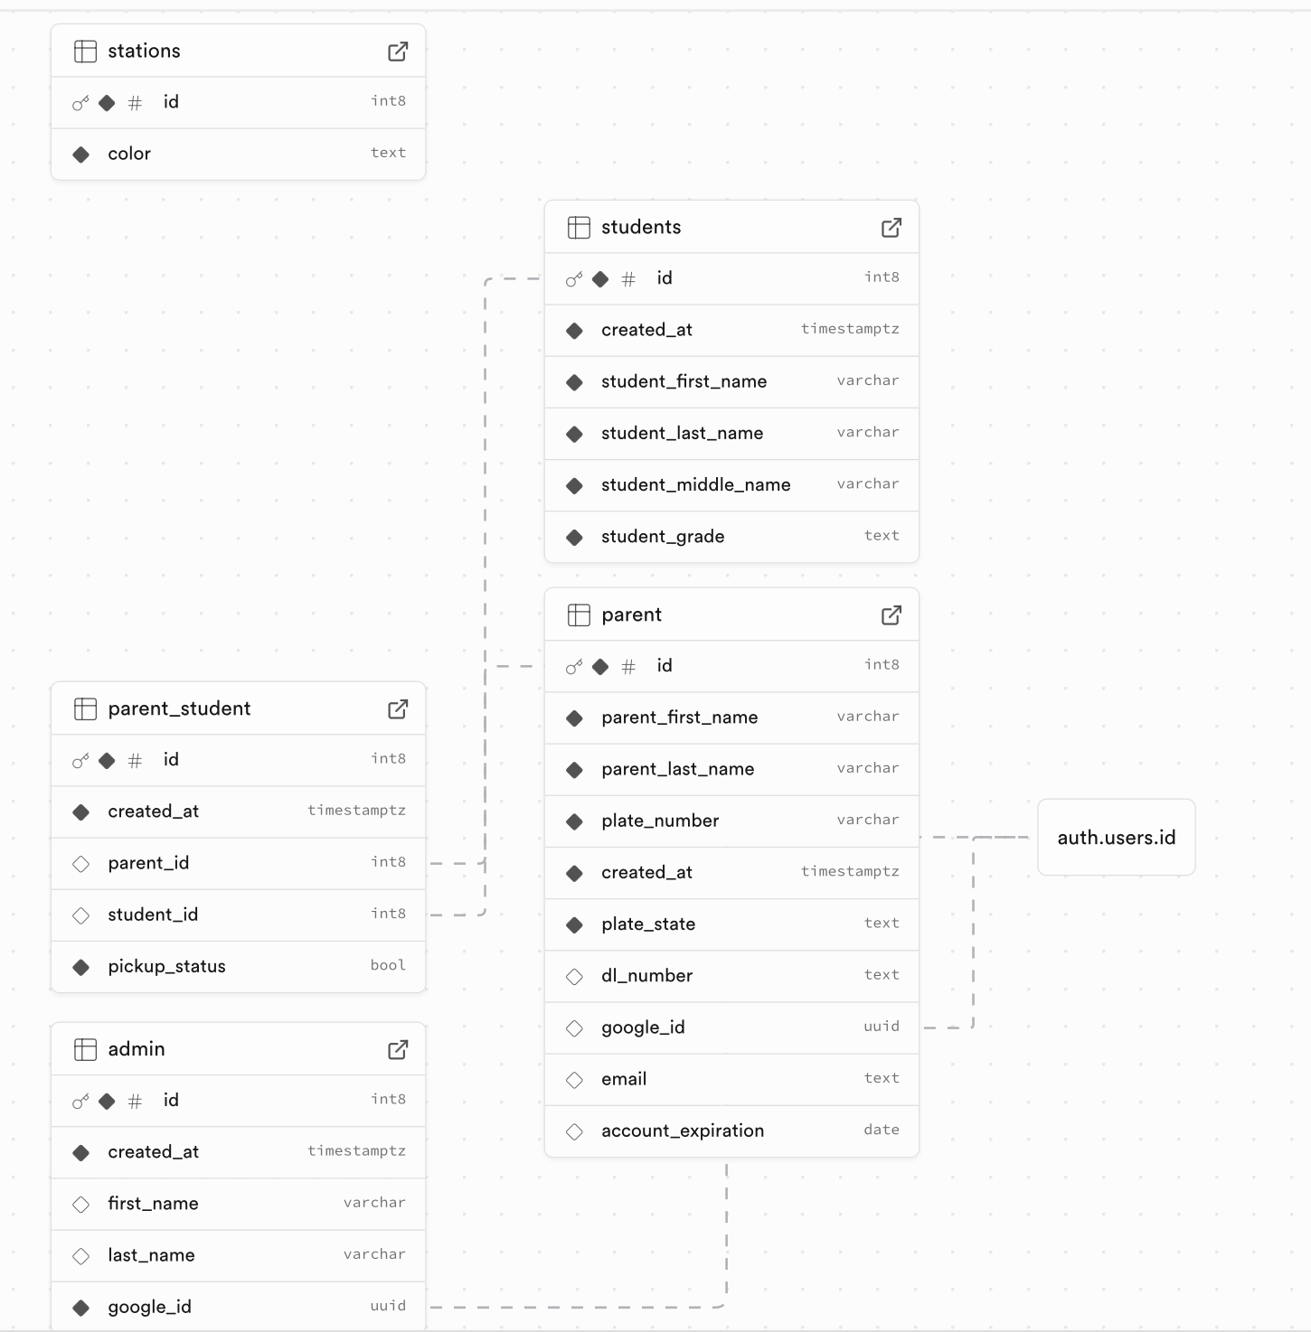
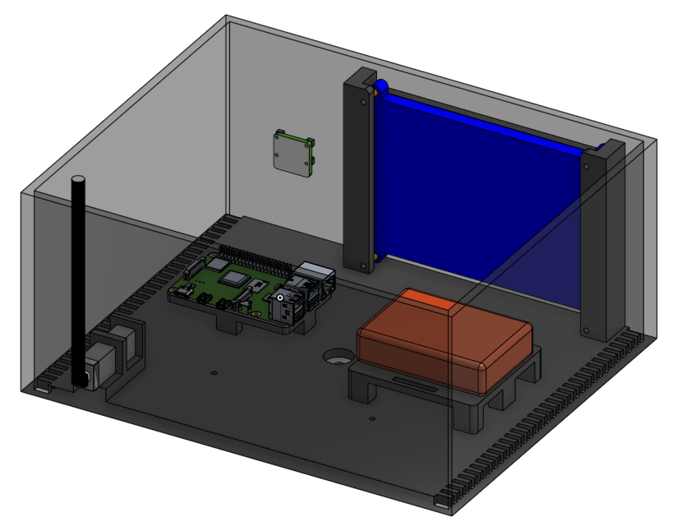
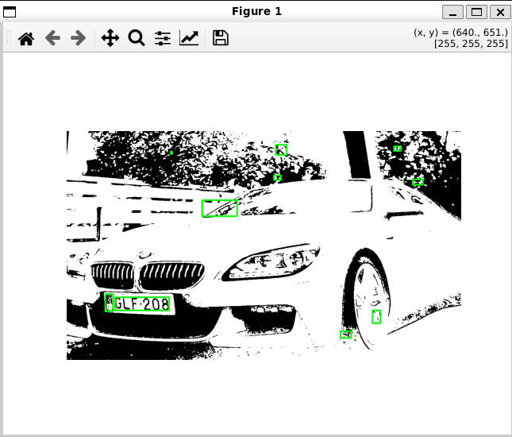
Preliminary Results
Database Implementation
PostgreSQL database created using Supabase
Tables implemented for:
Parent accounts
Student records
Parent–student relationships
Pickup status tracking
System successfully inserts, retrieves, and updates records
Hardware Progress
Raspberry Pi configured and connected via SSH
Camera module installed and tested
System can process images and detect license plates
Mechanical Development
CAD models created for device housing
Measurements completed for hardware mounting
Prototype enclosure design in progress

Slide 22
Questions?
Thanks for listening!

